Slide 1
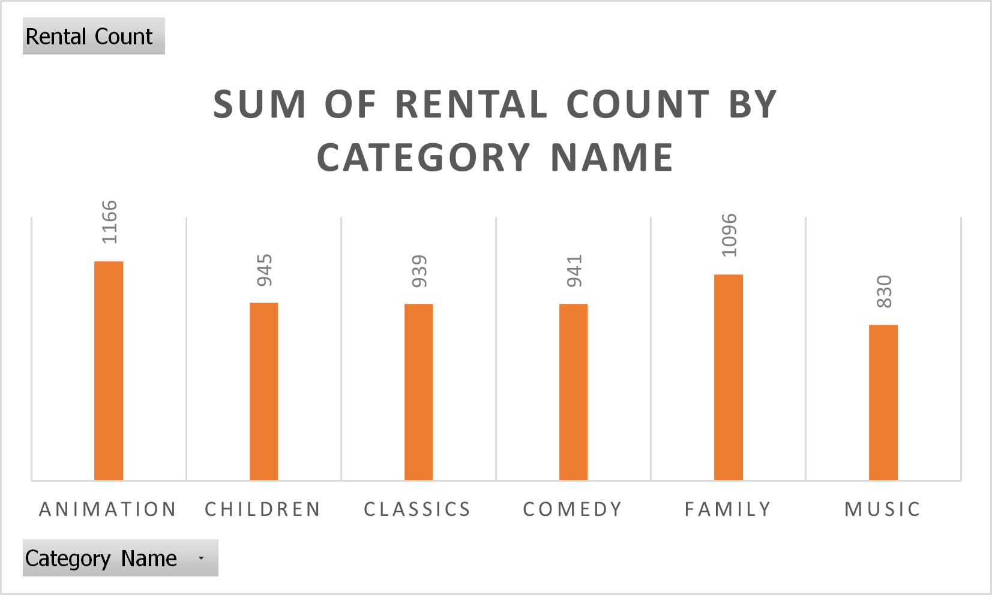
What is the most rented family friendly movies by category?
Here is the rented family friendly movies graph by rental count.
The most rented category is animation. Followed by family, children, comedy, classics and music.

Slide 2
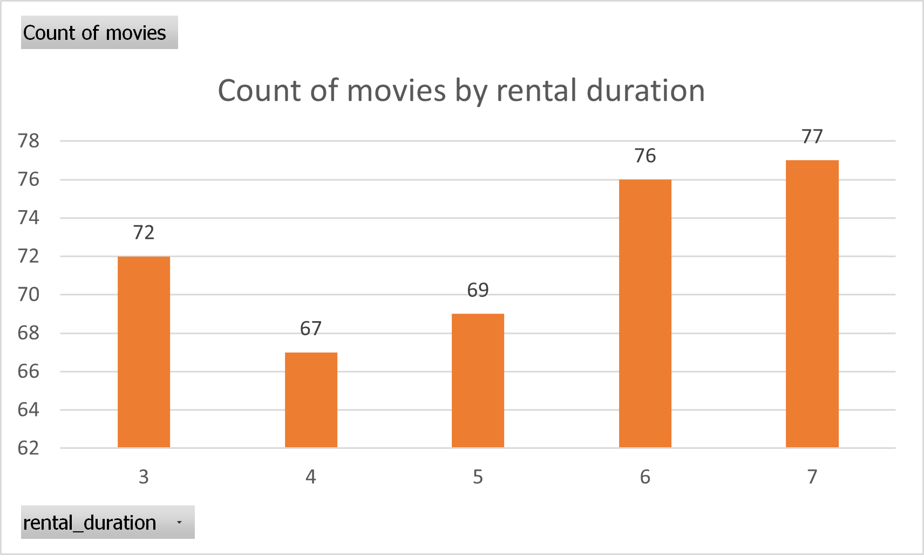
Compare the rental duration of movies by each period. What is the most movies rental duration?
On the graph we can see the count of movies has been rented in different periods.
Most movies rental duration is 7 with 77 movies. Followed by period 6 with 76 movies, period 3 with 72 movies, period 5 with 69 movies and period 4 with 67 movies..

Slide 3
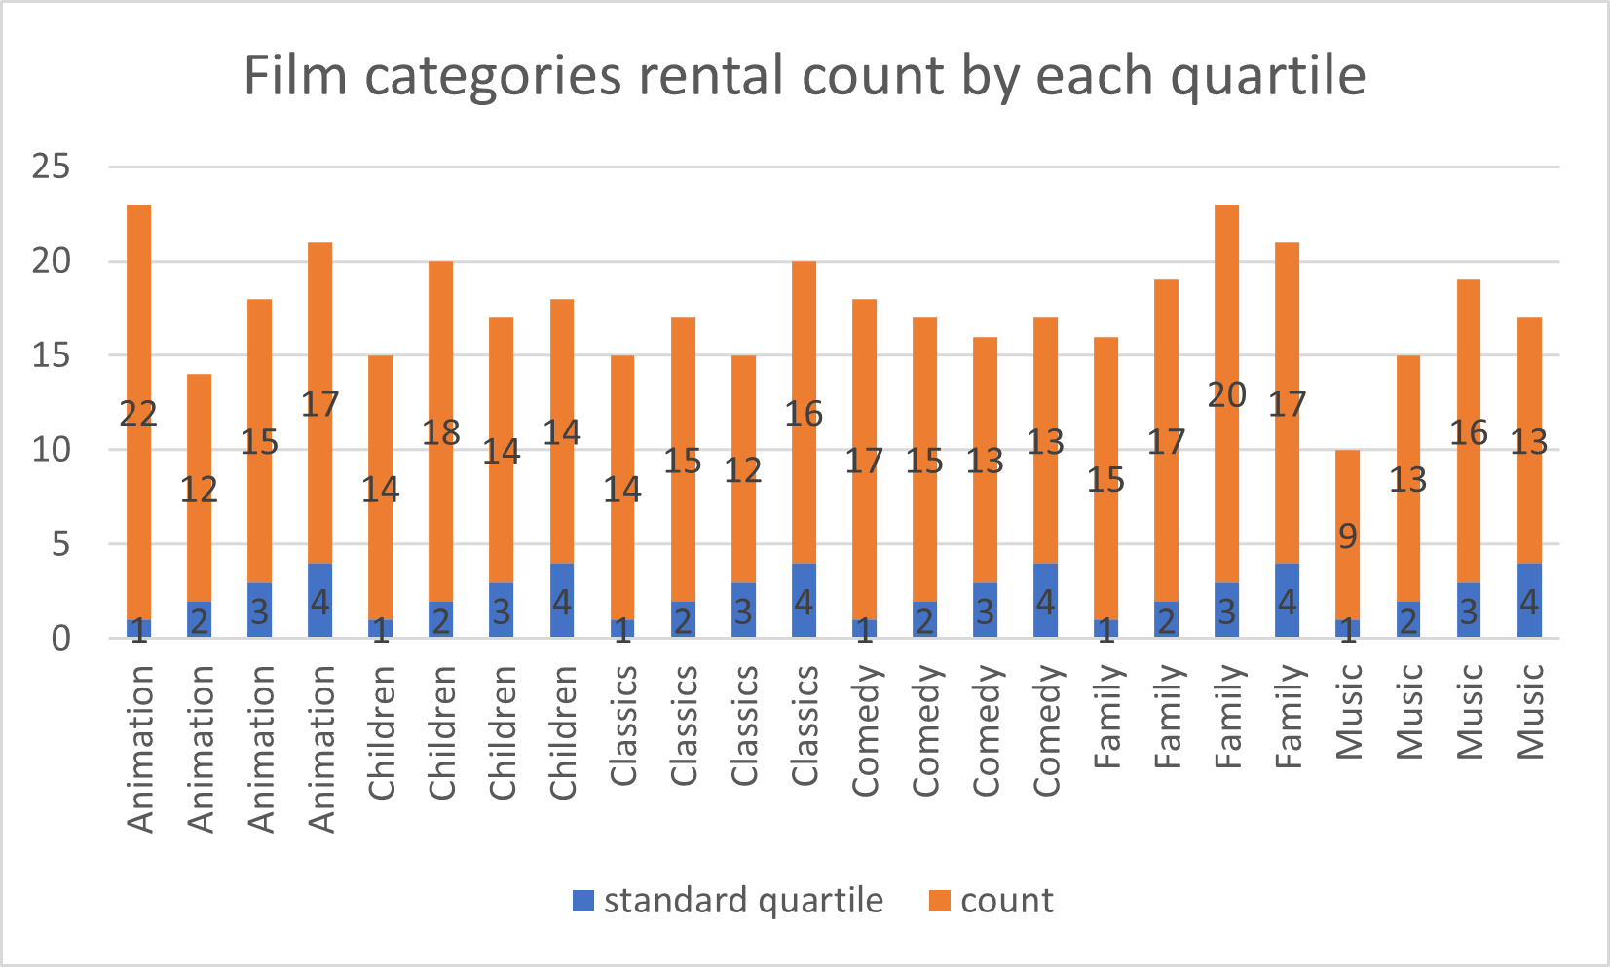
Which film category has highest rental duration in 1. quartile and which one has least rental duration in the 3. quartile?
On the left side, graph explain us the count of rented film categories by standard quartiles.
In the 1. quartile highest rental duration is Animation category by 22 times.
In the 3. quartile least rental duration is Classics category by 12 times.

Slide 4
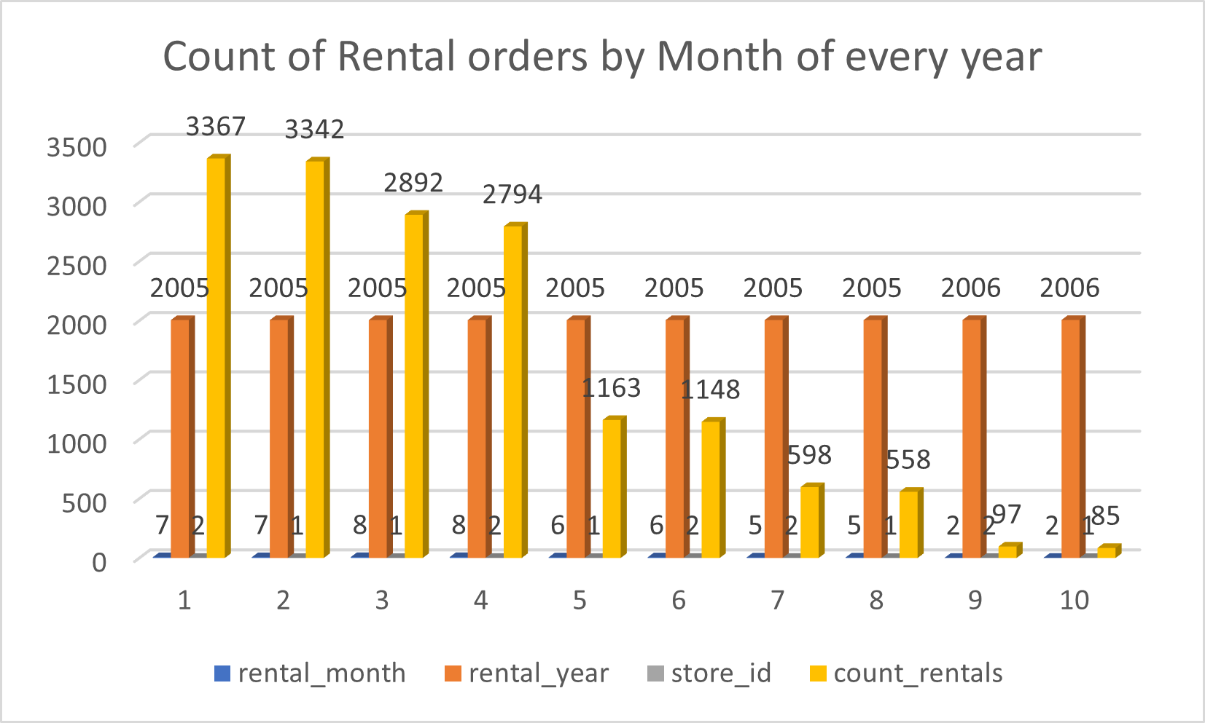
Compare two stores rental order by every month and which month has the highest rental count for store 1 and store 2?
On the graph we can see the rental orders of each month for store 1 and store 2.
Highest rental count for store 1 is month 7 and count 3342.
And highest rental count for store 2 is month 7 with 3367 count.

